Slide 1
Uniqueness of project
ANALYZING INCOME STATEMENTS AND BALANCE SHEETS USING LLM

Slide 2
Problem statement
Financial analysis, particularly the evaluation of balance sheets and income statements, remains a complex and time-intensive process. Manual workflows for extracting, analyzing, and reporting financial data are prone to errors, inefficiencies, and non-compliance with regulatory standards.
Organizations often face challenges in:
Data Overload: Managing and analyzing vast amounts of financial data quickly and accurately.
Human Errors: Mistakes in calculations, data entry, or regulatory compliance.
Lack of Insights: Difficulty in deriving actionable insights from static reports.
Scalability Issues: Inefficiency in processing financial reports for large enterprises with multiple subsidiaries.

Slide 3
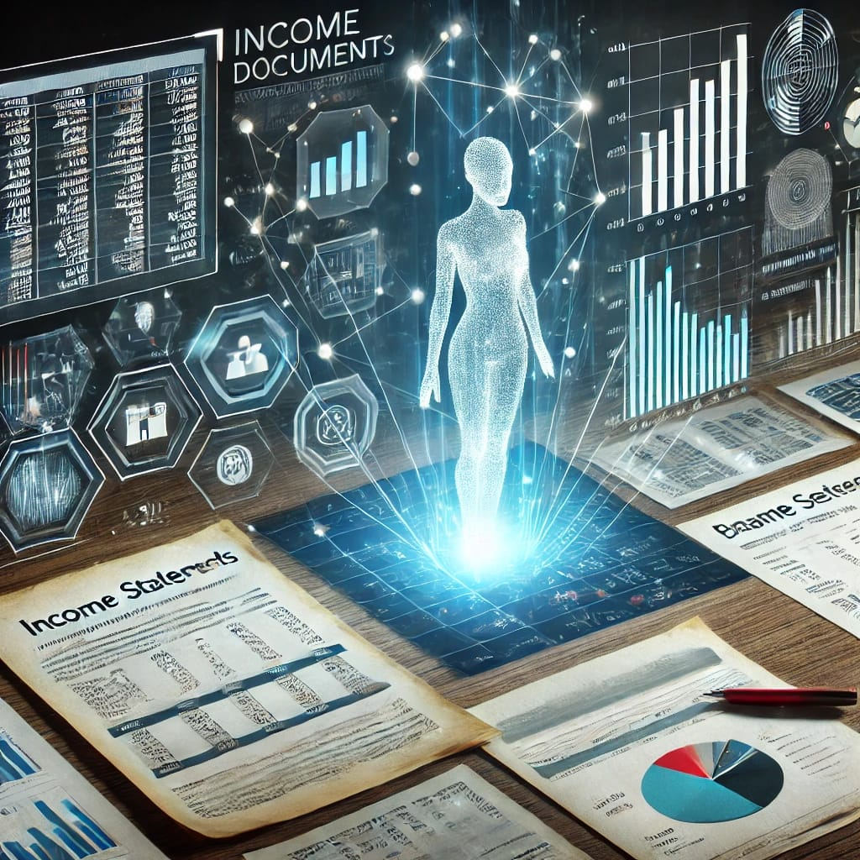
Why does this project
has to be done?
Efficiency and Accuracy: Automates financial workflows, reducing errors and saving time.
Improved Decision-Making: Provides actionable insights and predictive analytics for better strategies.
Regulatory Compliance: Ensures adherence to financial standards and creates audit-ready reports.
Scalable and Cost-Effective: Handles large data efficiently without additional resources.
Real-Time Analysis: Offers dynamic updates and insights for quick decision-making.

Slide 4

Example Context
A financial team in a global company may need to consolidate balance sheets and income statements across multiple subsidiaries.
Using manual processes:
It could take days to gather, clean, and consolidate data.
Errors in calculations or compliance could lead to financial penalties.
Identifying potential risks or trends may be delayed, impacting strategic planning.
With this project, an AI-driven solution could:
Automatically ingest financial reports from diverse sources.
Generate real-time consolidated statements.
Identify anomalies and generate predictive insights.
By implementing such a system, businesses can transform their financial analysis, reducing operational costs and enhancing strategic decision-making.

Slide 5

Applications
Risk Assessment: Analyses metrics to identify potential financial risks.
Financial Data Automation: Extracts, cleans, and structures financial data for analysis.
Real-Time Analysis: Generates financial ratios and identifies trends or anomalies.
Compliance & Reporting: Automates compliance-ready financial reports and ensures regulatory adherence.
Predictive Modeling: Uses AI to forecast future financial performance.

Slide 6
Example Application
Workiva is an application that benefits from the AI-driven financial data analysis system developed in this project. It automates financial reporting and enhances decision-making. Importance or Usage of Workiva:
Automated Reporting: Workiva generates financial statements automatically, reducing errors and manual effort.
Real-Time Analysis: Provides instant insights, enabling quick business decisions.
Collaboration Facilitates : efficient teamwork on financial documents, improving accuracy.
Compliance: Ensures reports meet regulatory standards, reducing risks.
Audit Trail: Tracks all changes, ensuring transparency and compliance.
This project enhances Workiva by integrating AI for more efficient financial data processing, real-time analysis, and ensuring regulatory compliance. It streamlines workflows, making financial reporting and analysis faster and more accurate.

Slide 7

How LLM benefits the project?
How Mistral AI benefits
the project?
Text Understanding: Extracts key financial data from documents.
Summarization: Provides concise summaries of reports.
Advanced Querying: Answers specific financial questions accurately
Efficient Parsing: Quickly processes and extracts data.
Real-Time Insights: Provides immediate, actionable financial insights.
Automated Compliance: Ensures reports meet regulatory standards.

Slide 8
why mistral AI and LLM are preferred?
Open Source and Cost-Effective: Mistral AI and LLMs are free to use and customizable, unlike proprietary tools that come with licensing or API fees.
Direct Document Analysis: These models can analyze financial documents directly, eliminating the need for extra tools or APIs.
Simplified Integration: Mistral AI and LLMs are easy to integrate into the project without requiring complex setups or external dependencies.

Slide 9
Key Features
partition_pdf: Extracts text, images, and tables from PDFs.
Table Recognition: Detects and extracts tables automatically.
Metadata Handling: Captures text format, layout, and table structure.
Table to HTML: Converts tables into HTML format.
Dependency Installation: Installs necessary tools for text extraction & OCR.
Environment Setup: Installs libraries for document processing and AI tasks.
Cross-Platform: Works across Linux, macOS, and Windows.
Automated Setup: Installs dependencies automatically.
Document Loading: Loads PDFs for processing.
DataFrame Conversion: Converts HTML tables into pandas DataFrame.
Hugging Face Integration: Utilizes Hugging Face transformers for AI- driven document processing.

Slide 10
Error Handling & Resource Management
Memory Optimization: Uses 8-bit quantization for efficient memory usage.
GPU Acceleration: Distributes model layers across available GPUs for faster processing.
Precision Control: Uses FP16 precision for a balance of performance and memory efficiency.
Optimized Performance: Combines techniques for faster inference without compromising quality.
Warning Suppression: Suppresses non-critical warnings for clean output and focused processing.

Slide 11
Thank You!

